Slide 1

CART Context
CART
Conservation Assessment & Ranking Tool
March 2019

Slide 2
Why CART?
Conservation planning can be implemented successfully using current knowledge and technology, while recognizing that the art and science of natural resource management will continue to evolve and will never be complete or finished. National Planning Procedures Handbook

Slide 3
CART Objectives
Streamline, Efficiency & Customer Service
Streamline Reading the Land
Efficient Conservation Planning and Ranking
Improve Services and Time to Interact with the Client
Program Neutral Planning informs Programs in a consistent, integrated process.
Adaptive Learning Framework
CART will be fully integrated into Planning and Program Policy. No Duplication of Work

Slide 4
CART Enhanced Field Office Workflow
Planner Pre-Screens as determined by State
Planner Creates Schedule
Pick PLUs
Planner Creates Assessment
Select RC
Assess Existing Condition including Existing Practices
Select New Practice
Planner Override
Collect Special Concerns Info
Complete Assessment
Planner Ranks Assessment Practices
Identify applicable Ranking Pools
Score Priority Questions
Finalize Score
Estimate Cost by Ranking Pool
Program Manager Selects Assessment and associated Practices by Ranking
Planner Completes Plan
Digitizes Practices
Contract Wizard
Planner Finalizes
Contract
Client Info and/or Field Visits conducted as appropriate
May Start Application, including eligibility, but must be completed by end of Ranking Process
Protracts
CD
CART
CPDES
FM
Configured Prior to Workflow
Resource Concern, Practices, and Points
Assessment Question Configuration
Geospatial
Questions
Spending Plan and line items
Program Manager Configuration of Ranking Pools
Geospatial
Questions

Slide 5
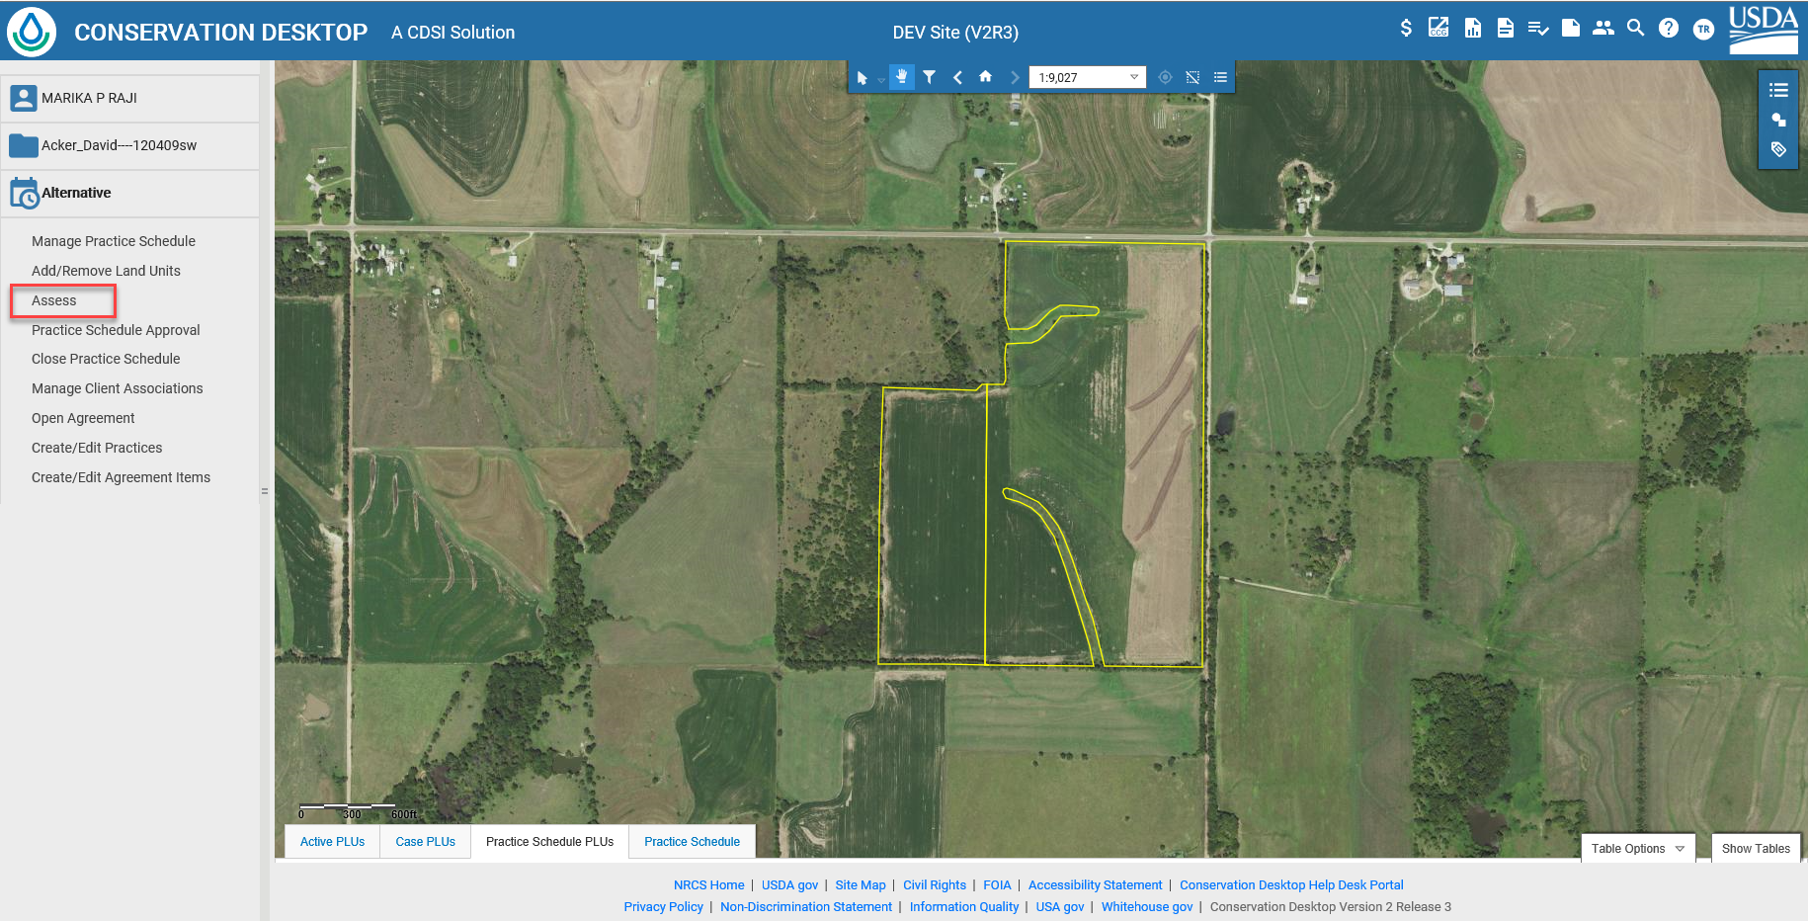
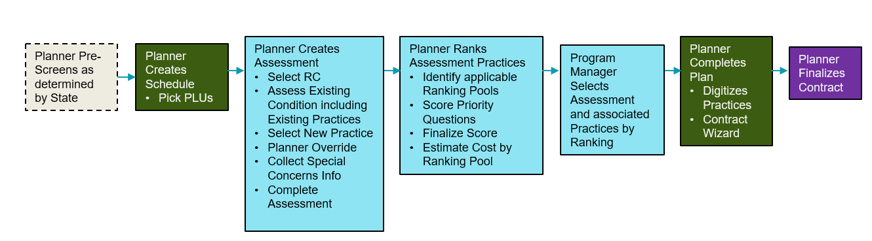
Conservation Desktop

Slide 6
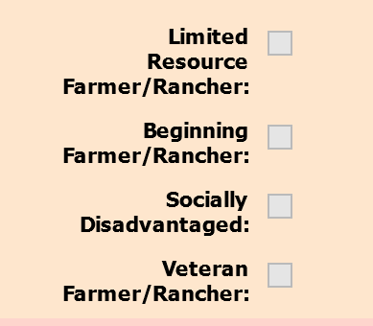
CART Assessment

Slide 7
Conservation Planning
Principles of Conservation Planning
(1) Consider the needs and capabilities of each acre within the plan
(2) Consider the client’s facilities, machinery, and economic situation
(3) Incorporate the client’s willingness to try new practices
(4) Consider the land’s relationship to the entire farm, ranch, or watershed
(5) Ensure the conservationist’s presence out on the land
Hugh Hammond Bennet

Slide 8
1. Identify Problems and Opportunities
CART Supports Client and Field Information with Geospatial Concern Evaluation. Planner will select resource concerns which present opportunities, concerns, or threats.
Special Resource Concerns
Wildlife – ex. Sage Grouse
Vulnerability – Leaching
Erosion
Soils
8

Slide 9
Determine Objectives
CART provides planning criteria to address the resource concerns and information about ecological site protection. Planner will identify Clients objectives for resource concerns which are evaluated and measured.

Slide 10
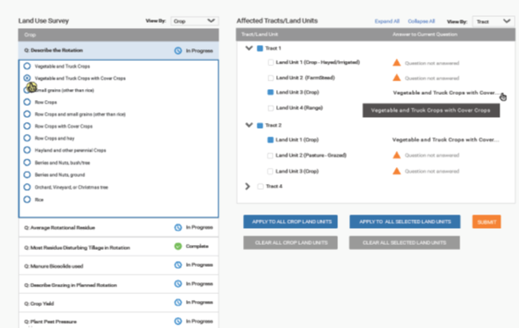
3. Inventory Resources
CART uses a resource inventory which incorporates geospatial data, existing practices, field visit, and client input.

Slide 11
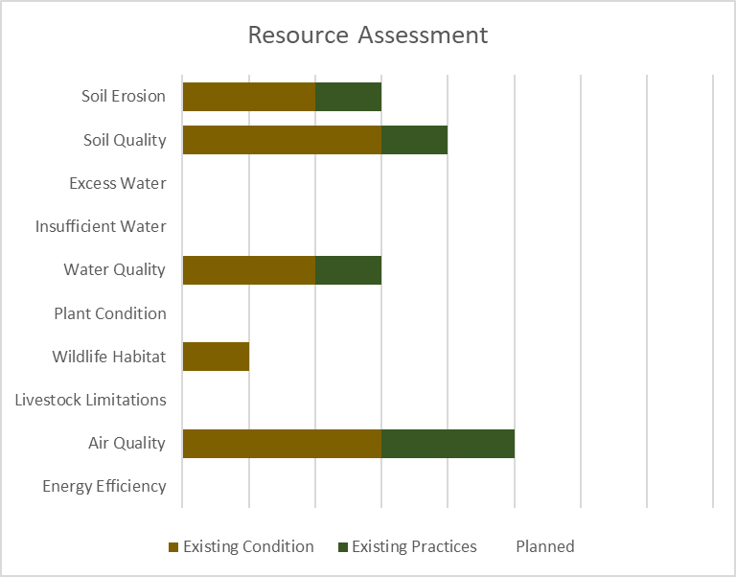
4. Analyze Resource Data
CART assists planners to analyze resource data captured in the inventory and compare against the planning criteria
+
+
+
+
+
+
+
+
+
+
Threshold
Existing Practices
Existing Condition

Slide 12
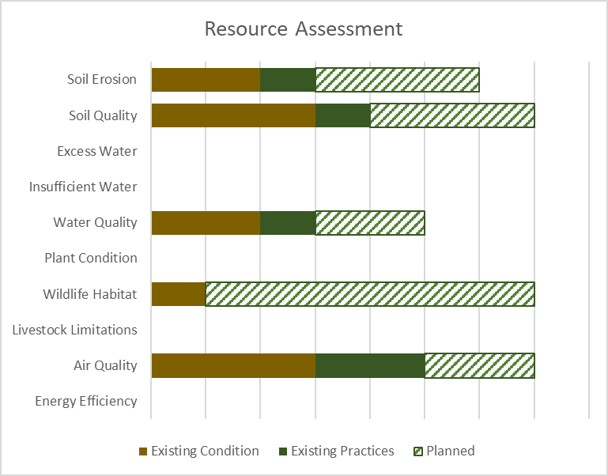
5. Formulate Alternatives
CART assists planners illustrate various alternative practices and their effect on the resource concern. Additionally, CART will identify funding sources to offset the expense of conservation practices
Threshold
+
+
+
+
+
+
+
+
+
+
Planned
Existing Condition & Practices

Slide 13
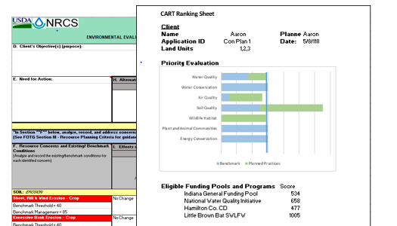
6. Evaluate Alternatives
CART will allow
Comparison of effects from different conservation practices
Multiple program ranking pools assessments for funding
Collection, recording, and evaluation of environmental assessment information currently captured on the CPA-52.

Slide 14
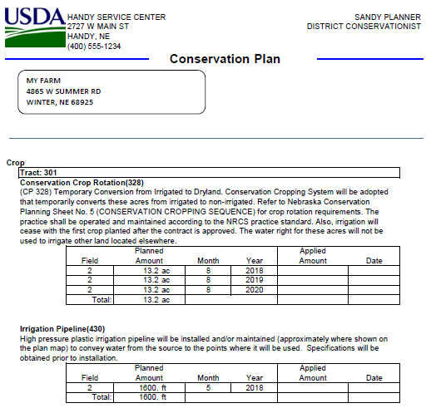
7. Make Decisions
CART will integrate with Conservation Desktop (CD) to turn the client’s selected alternative into a written conservation plan.
CART will also support Farm Bill program ranking for funding decisions. When the client choose to use a program, CART completes ranking using the already collected resource inventory and geospatial information to the greatest extent possible.

Slide 15
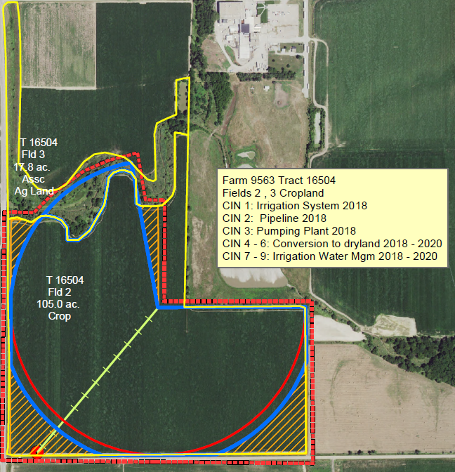
8. Implement the Plan
Conservation implementation is conducted primarily through CD and FOTG, but all CART data is available to CD and design tools for future integration with existing implementation requirements.

Slide 16
9. Evaluate the Plan
CART provides data to evaluate the effectiveness of the plan in meeting the conservation objectives.
CART will maintain resource and practice data to streamline development of any future updates to a client's conservation plan.
CART inventory and assessment values and methodologies will be updated as information is available each year.

Slide 17
Assessment Method Feedback
Conservation planning can be implemented successfully using current knowledge and technology, while recognizing that the art and science of natural resource management will continue to evolve and will never be complete or finished. National Planning Procedures Handbook

Slide 18
Resource Concern Teams
Assessment Methods were developed by volunteers on the CART resource concern team.
This team and associated workgroups included over 100 staff from all areas and disciplines within NRCS at both the National and State level.
Team charge was to develop a streamlined assessment process which maintained the program neutral planning process incorporating geospatial information to the extent possible, while capturing information which could be used to prioritize program implementation and delivery

Slide 19
Conservation Points
Conservation Points are
Good!
Good!
Good!

Slide 20
Ranking Pool (Resource Concern Met)
Resource Concern Met (Existing or Planned)
Planner Override
Existing Condition & Practices
Planned Practice Effects
+
<
Threshold or
Resource concern met by program and ranking pool:
Planner Overwrite only changed final Y/N Answer, not points
May establish program eligibility, such as CSP
May garner bonus resource concern points for Planned Condition Meeting Threshold

Slide 21
Site Vulnerability Impacts risk level to meet planning criteria Threshold
Low Risk
(15 Points)
Ex. Flat
Medium Risk
(50 Points)
Ex. Gently rolling
High Risk
(80 Points)
Ex. Steep Hillside
Notes:
Arows

Slide 22
Existing Condition & Practice
Existing Condition
Existing Practice
20 points
Ex. Medium Residue Crop
10 points
Ex. Filter Strip
0 Vulnerability
Ranking Points
15 Point Threshold
(Flat)
20 Vulnerability Ranking Points
50 Point Threshold
(Gently Rolling)
50 Point Threshold
50 Vulnerability Ranking Points
80 Point Threshold
(Steep Hillside)
80 Point Threshold
Notes:
Color connection with bars

Slide 23
Planned Practices
Existing Condition
Existing Practice
Planned Practices
20 points
Ex. Medium Residue Crop
10 points
Ex. Filter Strip
Planned Practices
40 Points
Ex. Cover Crop and Minimal Tillage
0 Vulnerability
Ranking Points
15 Point Threshold
(Flat)
20 Vulnerability Ranking Points
50 Point Threshold
(Gently Rolling)
50 Point Threshold
50 Vulnerability Ranking Points
80 Point Threshold
(Steep Hillside)
80 Point Threshold

Slide 24
Example
 | Water Erosion | Wind Erosion | Sediment | Nitrogen Surface Water
Threshold | 50 | 10 | 50 | 40
Existing Condition
Low Residue | 20 | 10 | 10 | 10
Existing Practices
Filter Strip | 0 | 0 | 15 | 5
New Practices
RM No-Till | 40 | 70 | 25 | 10
Planning Criteria Met
Existing | 20/50 | 10/10 Meets | 25/50 | 15/40
Planned | 60/50 Meets | 80/10 Meets | 50/50 Meets | 25/40
Notes:
Smaller image

Slide 25
Program Ranking
Local flexibility

Slide 26
Ranking Pool (Plan Assessment Points)
Existing Condition & Practices
Planned Practice
Effects
Threshold
-
+
Vulnerability
Plan Assessment points by ranking pool:
Plan Assessment points come from evaluating the Program Neutral Conservation Plan
Only resource concerns which are identified by the ranking pool will garner plan assessment points
Only practices on land uses which are identified by the ranking pool will garner plan assessment points

Slide 27
Planned Practices
Assessment Ranking Pts
Flat 0 Vulnerability +40 Planned Practices
Gently Rolling 20 Vulnerability +40 Planned Practices
Steep Hillside 50 Vulnerability +40 Planned Practices
Existing Condition
Existing Practice
Planned Practices
20 points
Ex. Medium Residue Crop
10 points
Ex. Filter Strip
Planned Practices
40 Points
Ex. Cover Crop and Minimal Tillage
0 Vulnerability
Ranking Points
15 Point Threshold
(Flat)
20 Vulnerability Ranking Points
50 Point Threshold
(Gently Rolling)
50 Point Threshold
50 Vulnerability Ranking Points
80 Point Threshold
(Steep Hillside)
80 Point Threshold

Slide 28
Ranking Prioritization AERT vs CART
Current Assessment Ranking Pts | AERT Priority | CART Assessment Ranking Pts | CART Priority
Flat +40 Planned Practices |  | Flat 0 Vulnerability +40 Planned Practices
Gently Rolling +40 Planned Practices |  | Gently Rolling 20 Vulnerability +40 Planned Practices
Steep Slope +40 Planned Practices |  | Steep Slope 50 Vulnerability +40 Planned Practices
1st
3rd
1st
2nd
1st
1st

Slide 29
Ranking Pool Use
Within CART each FY 2020 program Spending Plan (funding pools, subaccounts, and/or initiatives) will have a CART ranking pool.
Ranking pools will evaluate client’s applications for 5 main areas
Plan Assessment: Existing Vulnerability
Plan Assessment: Planned Practice Effects
Pool Priorities: Resource
Pool Priorities: Programmatic
Efficiency
The locally led process can have input on each of these
Notes:
subaccounts

Slide 30
Ranking Pool Use
Each Ranking Pool will be customized by the appropriate program manager after incorporating locally led input. Customizable aspects include:
Geographic Extent of Ranking Pool
Subdivisions for funding within Ranking Pool
Weighting between 4 aspects
Selection of Land Uses
Selection and Weighting of Resource Concerns
Selection of Conservation Practices
Applicability Questions or Geometry
Pool Resource Priority Questions and Geometry
Pool Programmatic Priority Questions and Geometry

Slide 31
Ranking Pool (Applicability)
A ranking pool will start to garner points if:
PLU(s) are within geographic boundary (Could have a percentage requirement of PLUs)
At least one resource concern is checked to assess for a resource concern identified as positively weighted for the ranking pool
Applicable Practices are in the Plan for the ranking pool
Applicability Questions are passed

Slide 32
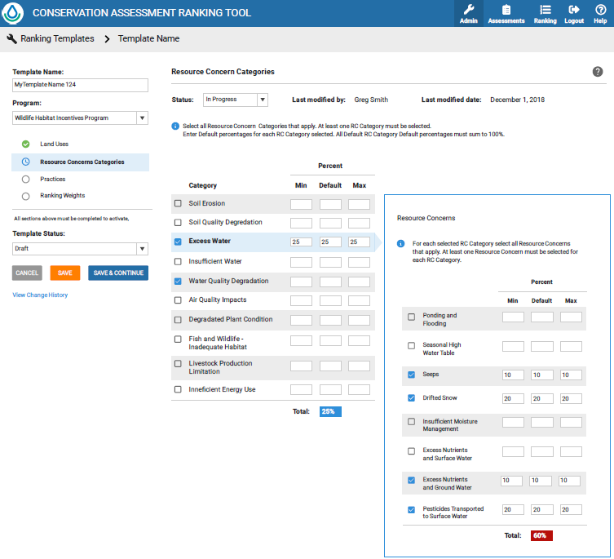
Configurable Ranking Pools

Slide 33
Pool Resource Priorities
Resource Priorities will be Ranking Pool Specific and may be either geospatial or question based.
Geospatial Based (ex. Priority Watershed)
Question Based (ex. Do the practices in the application affect sage grouse?)
Points awarded can be true/false or graded by priority
Multiple priorities can be considered for each ranking pool
Awarded at the application level, not by Planned Land Unit

Slide 34
Pool Programmatic Priorities
Programmatic Priorities will be Ranking Pool Specific and may be either geospatial or question based.
Geospatial Based (ex. Risk of conversion)
Question Based (ex. Veteran Farmer)
Points awarded can be true/false or graded by priority
Multiple priorities can be considered for each ranking pool
Awarded at the application level, not by Planned land unit and may be based on the client’s status

Slide 35
Efficiency
Plan Benefits from Applicable Practices
Average Annual Practice Cost
Weighted to result in meaningful score as identified by program
Notes:
Normalizing practive cost

Slide 36
Application Score Weighting
Set by ranking pool with bounds set by program
Old National, State, and local questions would be incorporated into Plan Assessment or Pool Priorities
Pool Weighting
Plan Assessment | Vulnerability | 20%
 | Planned Practice Effects | 30%
Pool Priorities | Resource | 30%
 | Programmatic | 10%
Efficiency Score |  | 10%
Application Score |  | 100%

Slide 37
Multi-Ranking Pool Evaluation
A Plan Assessment is made up of multiple practices which may be eligible under multiple ranking pools. CART will allow consideration for funding under all applicable ranking pools
Participants may be considered for funding in as many ranking pools as are applicable
Plans may receive funding from multiple ranking pools
CART will assure a practice is not funded twice on the same land unit by separate funding sources
Notes:
More examples

Slide 38
Conservation Plan
10 practices
1,2,3,4,5,6,7,8,9,10
All Practices are unique
RP #1
Practices
1,2,3,4,5,
6,7,8,9,10
RP#2
Practices
1,2,3,4,5
RP#3
Practices
6,7
RP#4
Practices
8,9,10
One contract
One contract

Slide 39
Assessment Feedback
Tell us like it is

Slide 40
Feedback Guidelines
Feedback for this round of review should focus on use-ability by field planners, streamlined and efficient planning delivery, and technical adequacy.
CART will be a configurable, continuous improvement system and will have multiple opportunities for review and feedback
The CART objective is to determine and document the need for additional conservation practices in a streamlined, efficient fashion. It is not to design the practices
CART will have a planner override function for each resource concern, so focus on the typical scenarios, not the exceptions
A wholistic list of conservation practices and enhancements with appropriate points will be provided for future comment. Suggestions for pointing practices will be accepted but not the focus of this review period.

Slide 41
Resource Concerns Assessments
CART will trigger resource concern assessment questions when:
Geospatial Analysis indicates the potential for a resource concern
Planner, through client input or field observation, indicates the potential for a resource concern by selecting it for assessment
CART will curate the assessment questions based on the resource concerns triggered. These will be presented in the CART user interface in the manner most efficient for data entry and to avoid duplication, which may differ from the order in the resource concern assessment

Slide 42
Assessment Method Structure
Resource Concern
Description: A description of the resource concern
Objective: NRCS objective to address this resource concern
Analysis within CART: The assessment method and questions proposed for use within CART. The analysis may be broken into component parts for a resource concern when multiple assessments or questions are needed to assess unrelated aspects of a resource concern
Typical Conservation Practices: These identify a small set of typical conservation practices for understanding and do not represent all the conservation practices which may have an effect on the resource concern or the final points for each practice

Slide 43
CART Resource Concern Inventory
The CART Inventory will capture resource inventory and bin this information into a number of categories using a relative vulnerability/benefit point system by resource concern. The resource concern points will fall into:
Threshold: Measure of Intrinsic Site Vulnerability and amount of conservation effort to reach a “sustainable” level
Existing Condition: What management activities existing, ex. rotation and associated residue
Existing Practices: What conservation practices may already be implemented and functioning on site
Planned Practices: What additional conservation practices are being evaluated for implementation
Priorities: Are there other priorities to consider, ex. critical watershed or wildlife habitat which are used in ranking

Slide 44
RC: Sheet and Rill Erosion (Crop)
Existing Method | CART Method
IET Completed for Existing and Planned Condition Outputs duplicated in CPA-52 Water Erosion rate <=T | Variable Geospatial Threshold Residue Condition Question Practices Erosion < Threshold (intent to be equivalent to T) Planner Override

Slide 45
Threshold: Sheet and Rill Erosion
Geospatial Field Soils Interpretation
Dominant Critical
K*(LS)/T into 4 vulnerability categories
Geospatially Determined R Factor
Runoff Vulnerability | R Factor
 | ≤50 | >50-150 | >150-250 | >250
High | 30 | 40 | 60 | 80
Moderately High | 20 | 30 | 50 | 60
Moderate | 10 | 20 | 40 | 50
Low | 10 | 10 | 20 | 40
50
Sheet and Rill Erosion

Slide 46
Existing Condition: Sheet and Rill
Crop Rotation Residue
Low Residue
20
0
10
20
40
60
80
No Residue
Very Low Residue
Low Residue
Moderate Residue
Moderately High Residue
High Residue
Existing Condition Question Triggered. May have already been triggered and answered by another resource concern
50
Sheet and Rill Erosion
46

Slide 47
Existing Practices: Sheet and Rill
Existing Practices
0
0
20
Filter Strip
Functioning
Grass Waterway
Non-Functioning
Existing Practices. May already be in the system or may be added by the planner
Contour Buffer
Functioning
50
Sheet and Rill Erosion
47

Slide 48
New Practices: Sheet and Rill
New Practices
Filter Strip
Functioning
0
0
20
30
Grass Waterway
Non-Functioning
Contour Buffer
Functioning
Residue Management
Planned
Planner Override
50
Sheet and Rill Erosion
48

Slide 49
RC: Streambank Erosion (Crop)
Existing Method | CART Method
SVAP2, paper copy Information repeated in CPA-52 No explicit connection to practices | One Question consistent with SVAP2 answer set Practice evaluation

Slide 50
Threshold: Streambank Erosion
Set threshold at 50, Consistent with existing assessment method of SVAP Bank Condition Element >=5
50
Streambank Erosion

Slide 51
Existing Condition: Sheet and Rill
Bank Erosion Condition
Moderately Unstable
25
60
51
25
1
Stable
Moderately Stable
Moderately Unstable
Unstable
Existing Condition Question Triggered. May have already been triggered and answered by another resource concern
Feedback: Add
Unstable, but beyond clients control
Unstable, but commensurate with normal geomorphological processes
50
Streambank Erosion
51

Slide 52
New Practices: Streambank Erosion
New Practices
Critical Area Planting
Planned
25
No existing practices
Planner Override
50
Streambank Erosion
52

Slide 53
RC: Subsidence (Any)
Existing Method | CART Method
Client Input/Planner observation 6-Notes and duplicated in CPA-52 Managed to Client’s Objectives | Variable Soils Interpretation Threshold One Concern Question

Slide 54
Threshold: Subsidence
Geospatial Field Soils Interpretation
Subsidence Interp
Mineral Soil | No threshold set, not trigger
Low | 20
Moderate | 40
Severe | 50
40
Subsidence

Slide 55
Existing Condition: Subsidence
Subsidence Condition
Not a Concern
51
1
51
Soil limiting
Not a concern
40
Subsidence
55

Slide 56
New Practices: Subsidence
New Practices
Drainage Water Mgmt
Planned
25
Planner Override
40
Subsidence
56

Slide 57
RC: Plant Productivity and Health (P & H)
Existing Method | CART Method
RHA Completed or Range Condition Score Outputs duplicated in CPA-52 RHA slight to moderate or better or range condition score > 60 | 2 Existing Condition Questions Practices

Slide 58
Threshold: Plant P & H
Set threshold at 50
50
Plant Productivity & Health

Slide 59
Existing Condition: Plant P & H
Plant Vigor
Moderate
20
0
10
20
40
60
None to Slight
Slight to Moderate
Moderate
Moderate to Extreme
Extreme to Total
Existing Condition Question Triggered. May have already been triggered and answered by another resource concern
Plant Productivity
Moderate
20
0
10
20
40
60
None to Slight
Slight to Moderate
Moderate
Moderate to Extreme
Extreme to Total
50
Plant Productivity & Health
59

Slide 60
New Practices: Plant P & H
New Practices
20
Brush Management
Planned
Planner Override
50
Plant Productivity & Health
60

Slide 61
Feedback
Bulletin 440-19-9 PGM – Review of CART Resource Concern Assessment Documentation. April 19 Deadline.
CART sharepoint: https://directives.sc.egov.usda.gov/43251.wba
User Acceptance Testing starting now and each iteration
Second Round of Comment in July-August
Notes:
More UAT

Slide 62
Planned Training
April 18-19 CD 2.2/Geoportal
June How to build a Ranking Pool (Program Staff)
July Mission Implementation (SRC/Programs Meeting)
August Farm Bill Implementation
August 26-30 CD 2.3/CART 1.0 Train the Trainer
Sept 9-13

